Slide 1
Lecture no : 13 k-MEDOID CLUSTERING

Slide 2
What is k-medoid clustering
K-medoids is a method used to group data into k clusters. Each cluster is represented by one of the actual data points, known as a medoid, rather than an average point used in other methods like k-means. The goal of k-medoids is to choose these medoids so that the total difference (or dissimilarity) between them and all other points in their cluster is minimized. This makes k-medoids good at dealing with different types of data and robust against outliers, since it doesn’t rely on averages which can be skewed by extreme values.

Slide 3
How it works:
Initialization: Select k initial medoids from the dataset.
Assignment step: Assign each data point to the nearest medoid, based on a chosen distance metric (like Manhattan Distance)
Update step: For each medoid and each point assigned to the medoid, calculate the total cost of swapping the medoid with the point. If any swap reduces the cost of the clustering, perform the swap to make that point the new medoid.
Repeat: Continue the assignment and update steps iteratively until no improvements or changes are found, indicating that the algorithm has converged.

Slide 4
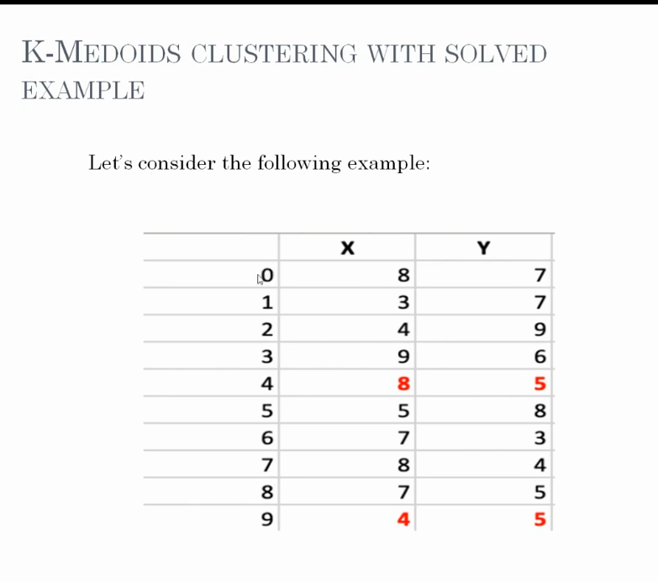
K-medoid clustering

Slide 5
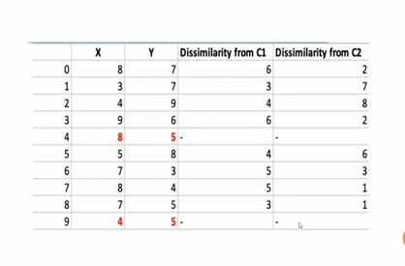
Continue:

Slide 6
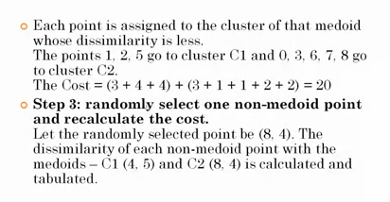
Continue:

Slide 7
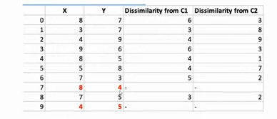
Continue:

Slide 8
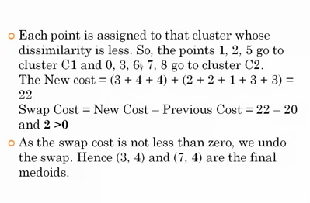
Continue:

Slide 9
Advantages:
Robustness: K-medoids is more robust to noise and outliers compared to k-means because it minimizes a sum of dissimilarities rather than squared Euclidean distances.
Flexibility: It works with any distance metric, making it versatile for various kinds of data that may not be well-suited to Euclidean distances.

Slide 10
Disadvantages:
Computational cost: The need to compute all costs for swapping between potential medoids and data points can make k-medoids more computationally expensive than k-means, especially for large datasets.
Sensitivity to initial selection: The initial choice of medoids can affect the final results, although less so than k-means because of its robustness to outliers.

Slide 11
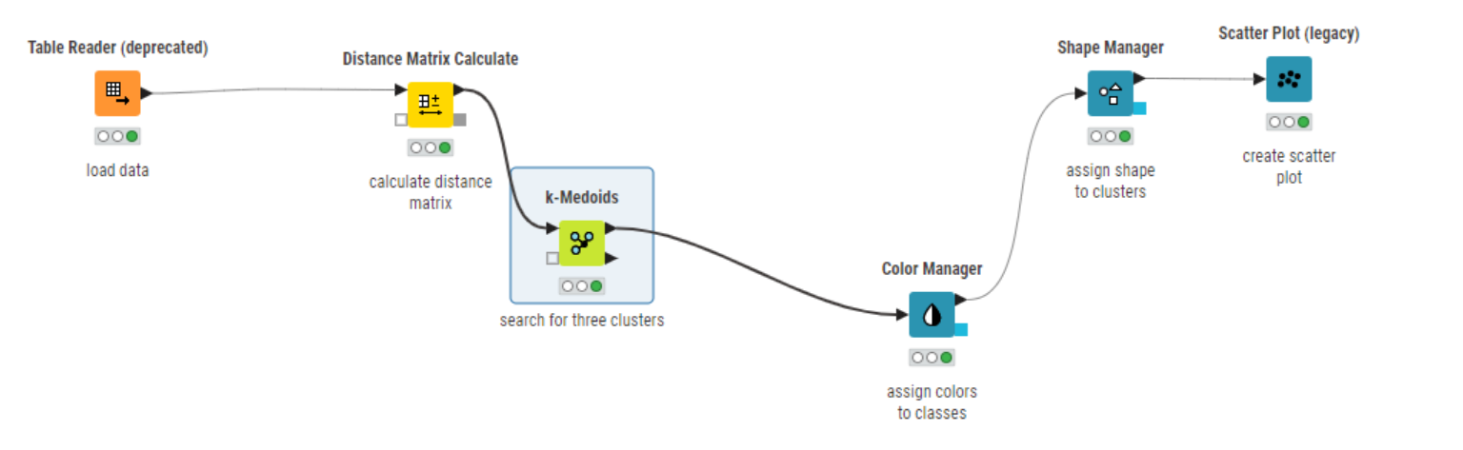
K-medoid in knime:

Slide 12
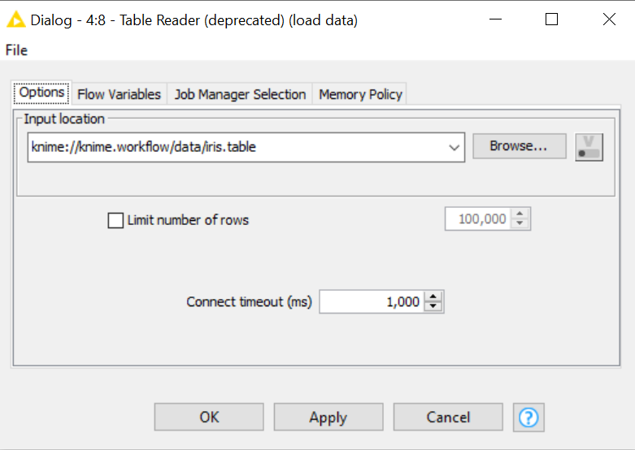
Continue:

Slide 13
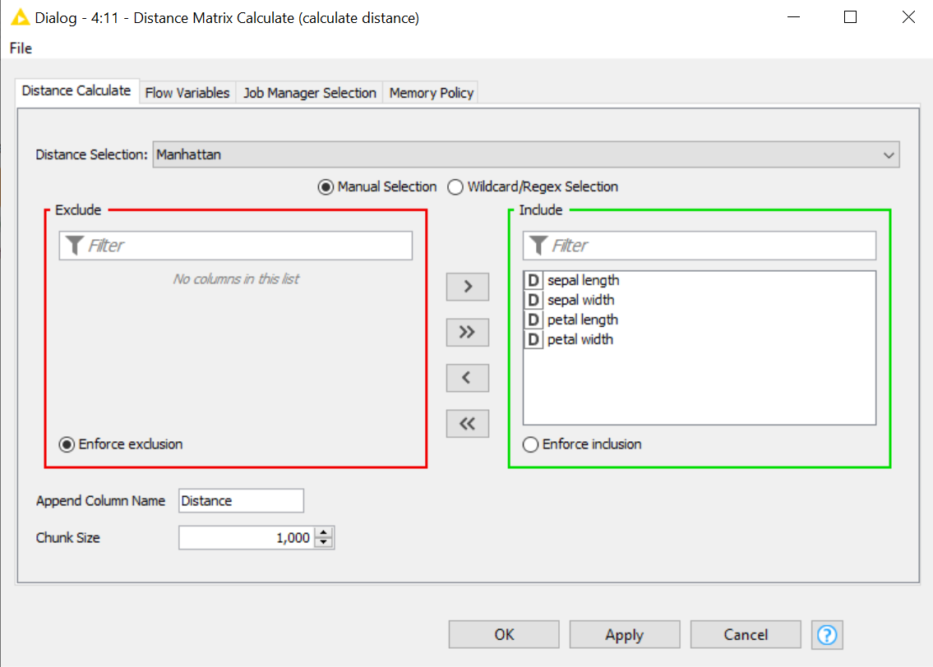
Distance matrix calculation using Manhattan distance

Slide 14
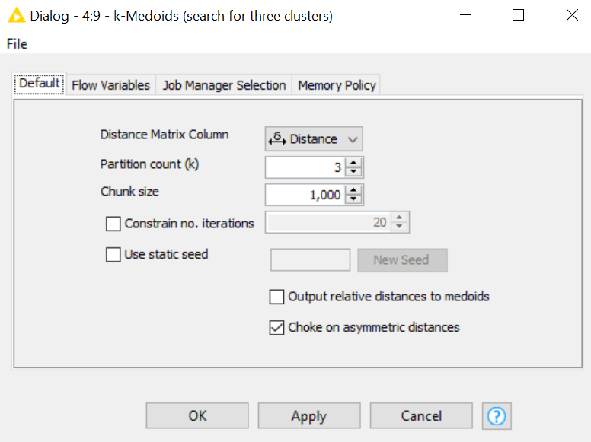
K-medoid clustering:

Slide 15
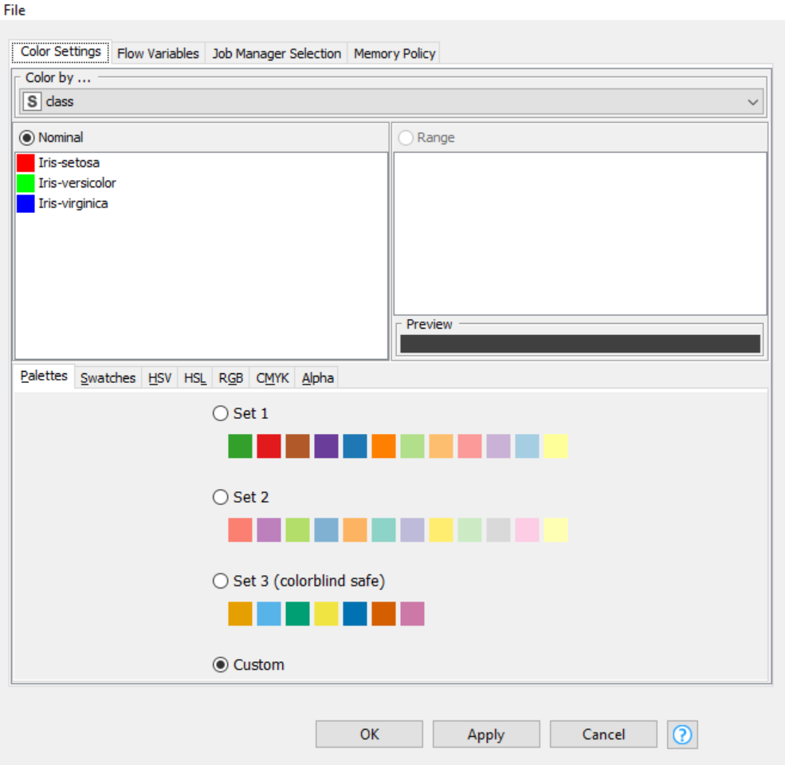
Color manager

Slide 16
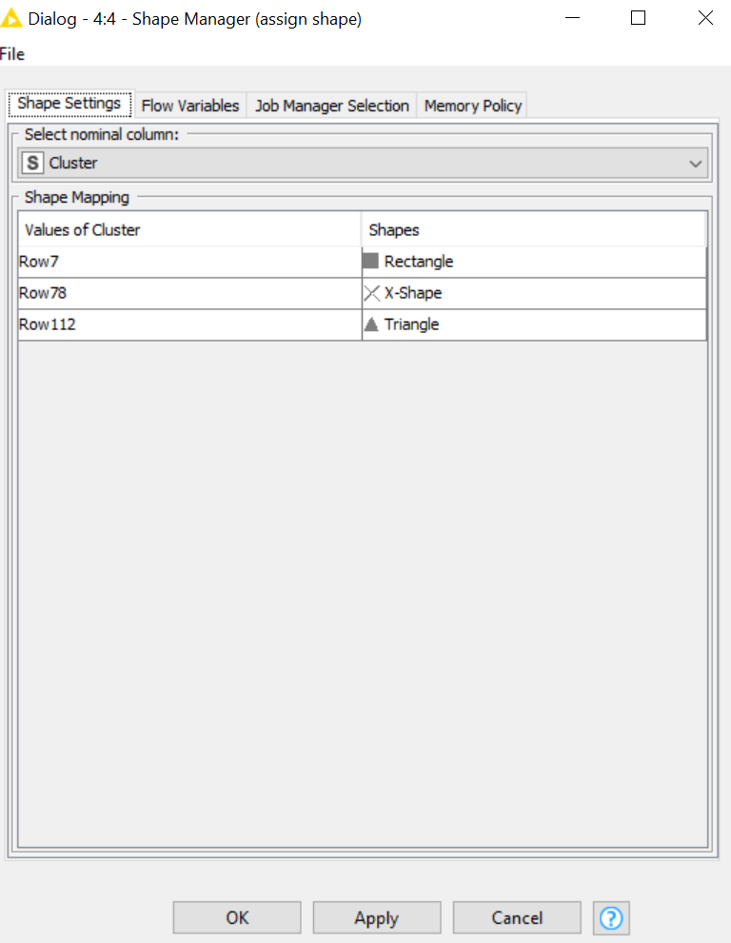
Shape manager:

Slide 17
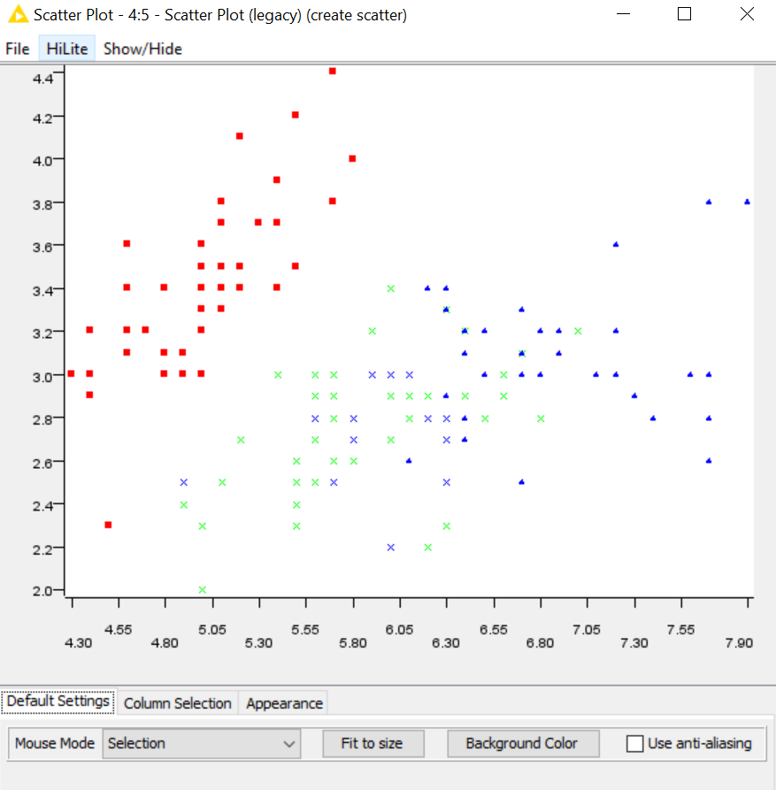
Scatter plot showing clustering:

Slide 18




Tasks:

Slide 19


Task 1:
Scenario: Market Segmentation Analysis
Objective: Use k-medoids clustering in KNIME to segment a customer database into distinct groups based on purchasing behaviors and demographics. This segmentation will help identify unique customer profiles, which can be targeted with tailored marketing strategies.
Dataset: Retail Market Segmentation Dataset

